Slide 1
.NET & Azure
Introduction & Quick Overview

Slide 2
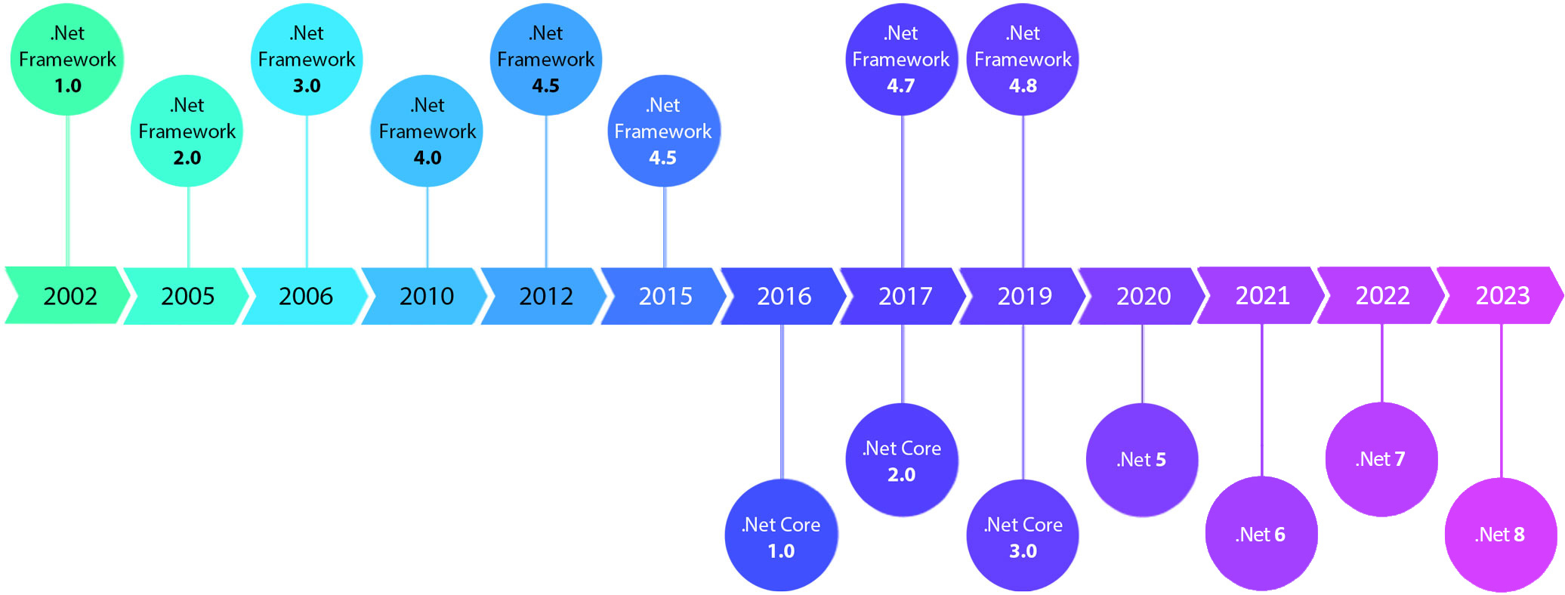
What is .NET
.NET is Ecosystem
CLR is JVM
C#, F#, VB, others are Java, Groovy
Ms
msbuild/Nuget is NPM/Gradle/Maven
Base Class Library (BCL) is Class Library
Visual Studio is Eclipse, IntelliJ
ECMA/ISO and other implementations Mono / nanoFramework
Azure Effect: Windows & .NET
Open source / Multi-platform / Xamarin
Notes:
https://www.youtube.com/watch?v=bEfBfBQq7EE
https://developer.microsoft.com

Slide 3
.NET: Approachable
IDE: Visual Studio (The Classic Way)
CLI: .NET SDK (and editor of your choice)
Notebooks (Jupyter / Data Science Style)
Notes:
- Visual Studio is the IDE for .NET and C++ developers on Windows; its Community Edition is free and its as good as Professional Edition
- https://visualstudio.microsoft.com/downloads
- CLI / Other IDEs; .NET SDK can be downloaded and you can use Visual Studio Code, JetBrains Rider and others (Eclipse, SharpDeveloper, MonoDevelop etc)
- https://dotnet.microsoft.com/en-us/download/visual-studio-sdks
- https://www.jetbrains.com/rider
- Jupyter Notebook; You can use Visual Studio Code and use C#/F# in Polyglot Notebooks
- https://code.visualstudio.com/docs/languages/polyglot
- https://devblogs.microsoft.com/dotnet/polyglot-notebooks-december-2022-release

Slide 4
Demos
Visual Studio Intro (Versions & Overview)
CLI Demo
Notebooks Demo

Slide 5
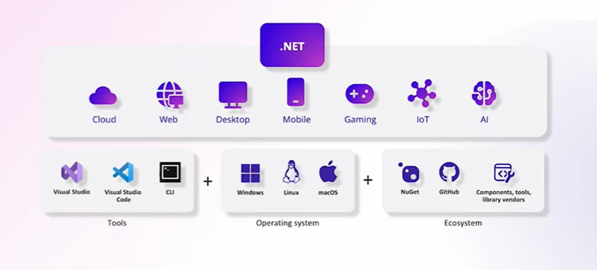
.NET Breadth & Depth
Windows Apps: Console Applications; Windows Service; Windows Forms, Windows Presentation Foundation UWP / WinUI, .NET MAUI, Blazor Hybrid
Component Services (COM+ / Enterprise Components)
Web: ASP.NET WebForms MVC, Minimal APIs
Blazor
Mobile: Xamarin (Android, iOS) .NET MAUI
Gaming: XNA Unity
AI: ML.NET Semantic Kernel
Notes:
https://dotnet.microsoft.com/en-us
https://aws.amazon.com/developer/language/net

Slide 6
Demos
Visual Studio Projects Demo

Slide 7
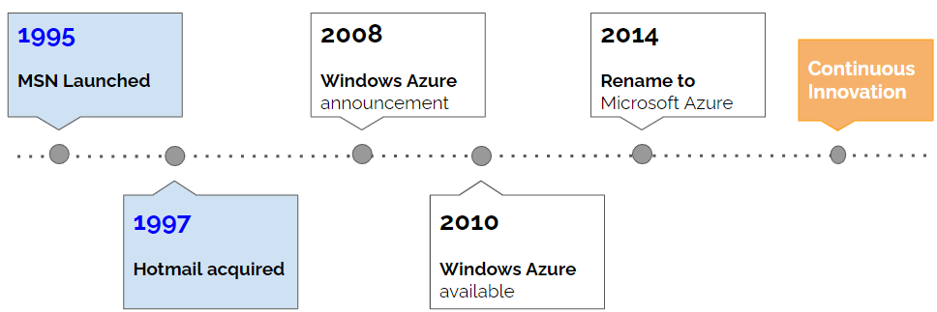
What is Azure
Azure: Any Language; Any Platform
Azure: Traditional Hosting Services
Azure: Typical Cloud Service
Azure: Infrastructure
Azure: Third Party Solutions & Services Elastic, Oracle, SAP
Azure: Microsoft Cloud Products / Services
Azure: Services AI, Data, Messaging, IoT and others
Notes:
https://techcommunity.microsoft.com/t5/educator-developer-blog/the-history-of-microsoft-azure/ba-p/3574204
https://cloudblogs.microsoft.com/windowsserver/2015/05/06/microsoft-loves-linux

Slide 8
Demos
Azure Portal / Services
uWorx Sample Services
Any Language; Any Platform

Slide 9
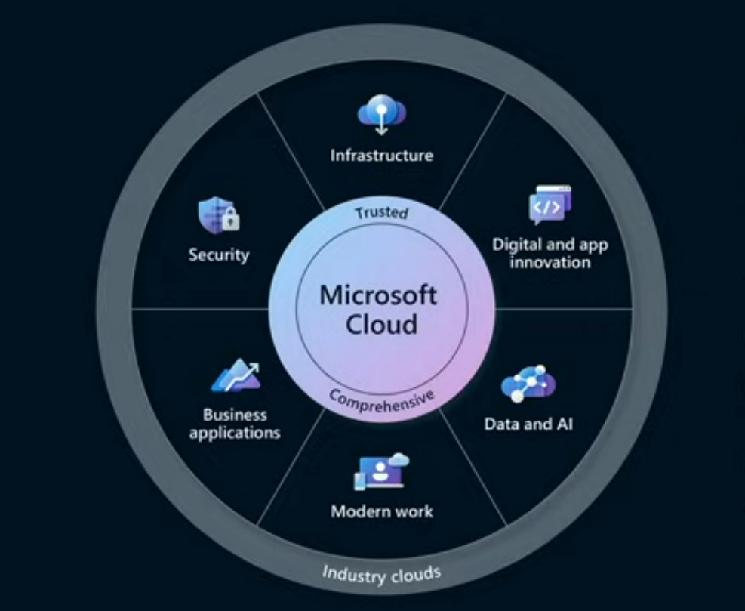
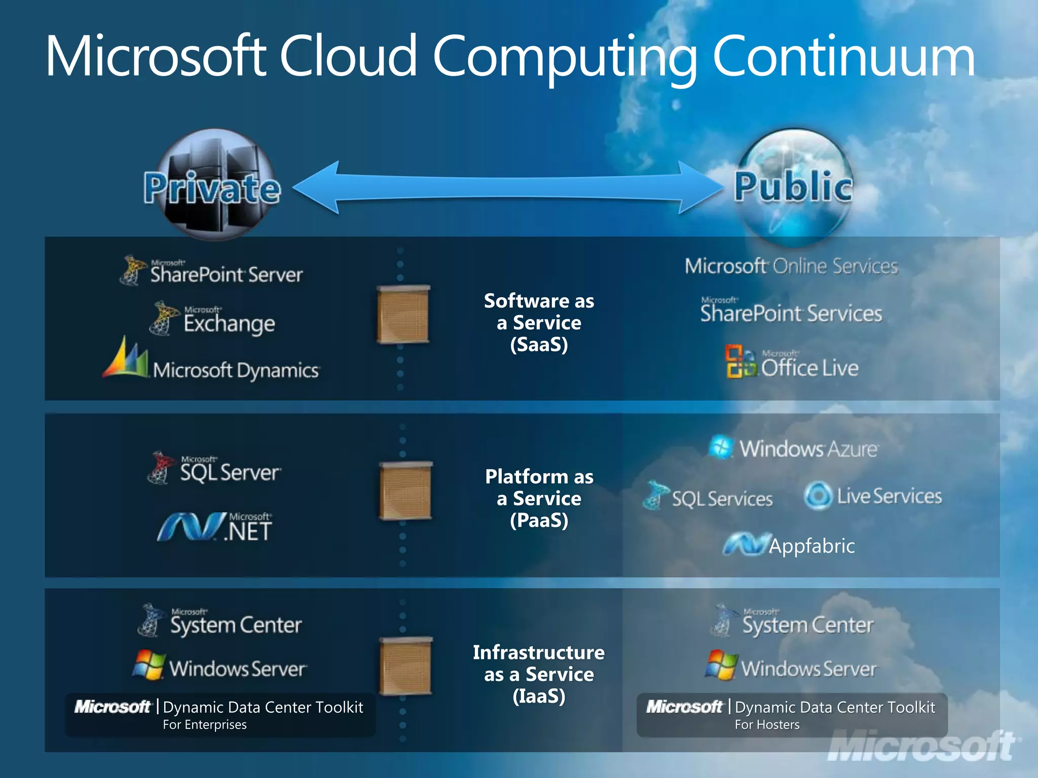
Azure: Breadth & Depth
Infrastructure: SDN and Identity Services
Productivity; Teams / Office; PowerApps; Power BI
Data: Databases, Fabric
Developer Tools DevOps, Testing, Publishing, Monitoring
IoT / AI

Slide 10
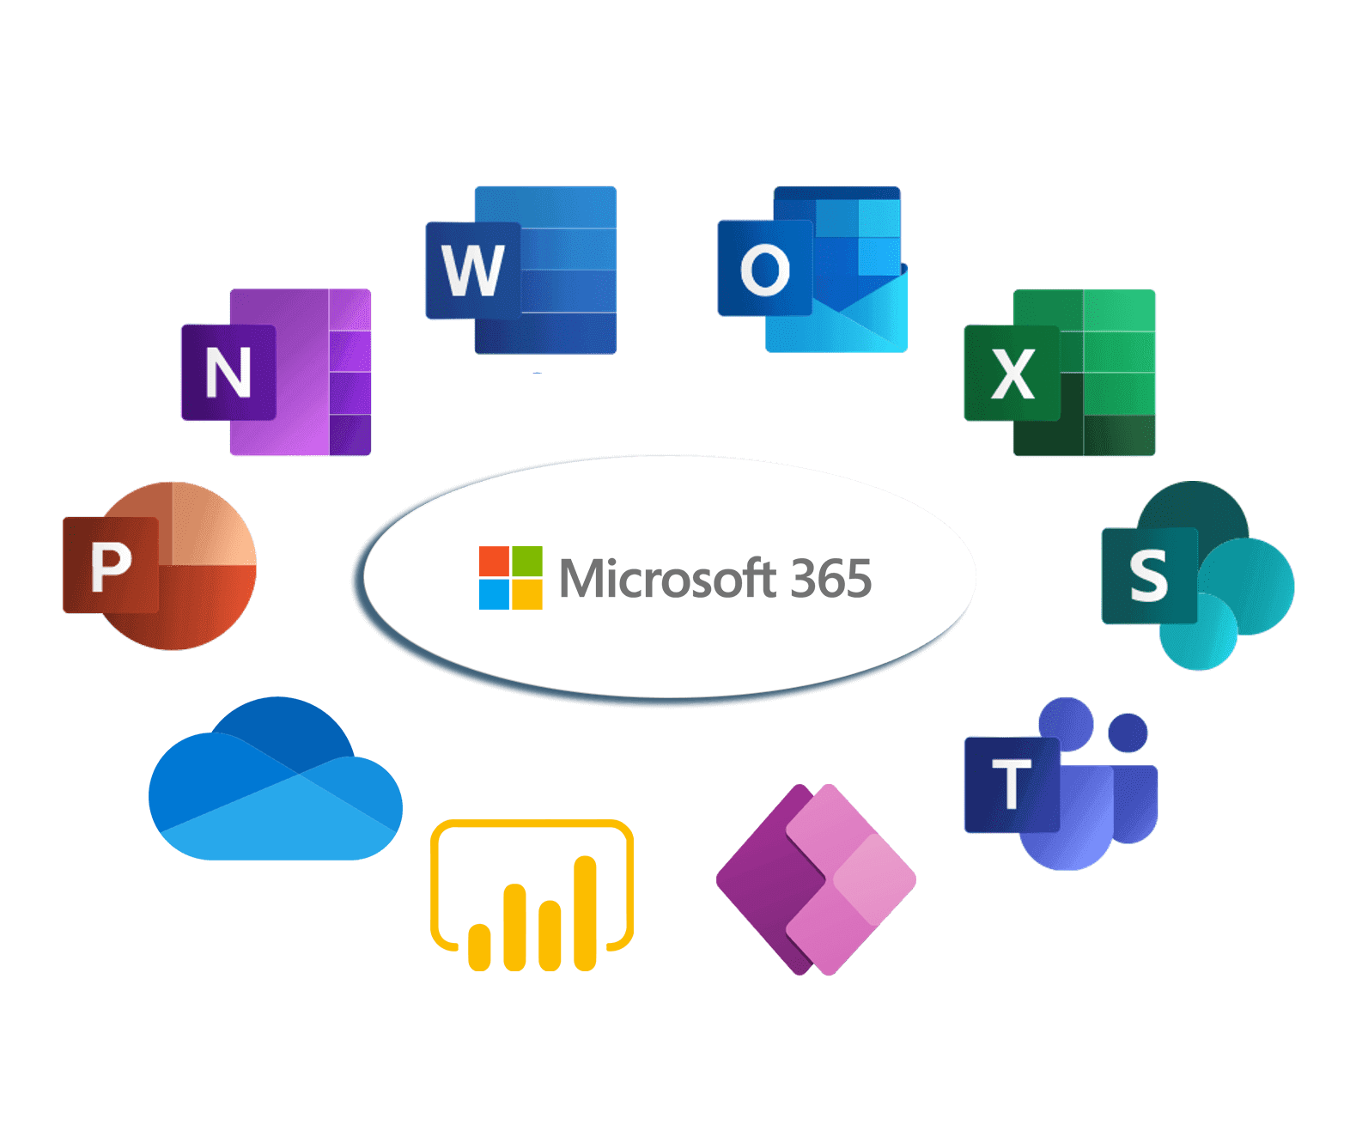
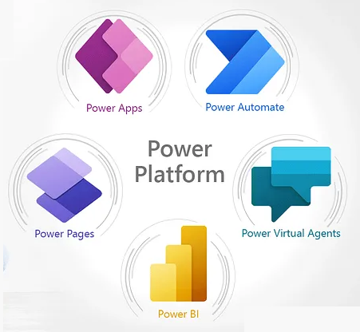
Microsoft 365 | Power Platform
Notes:
The Microsoft Graph | Cloud Storage | Security | Windows

Slide 11
Demos
Office Sandbox

Slide 12
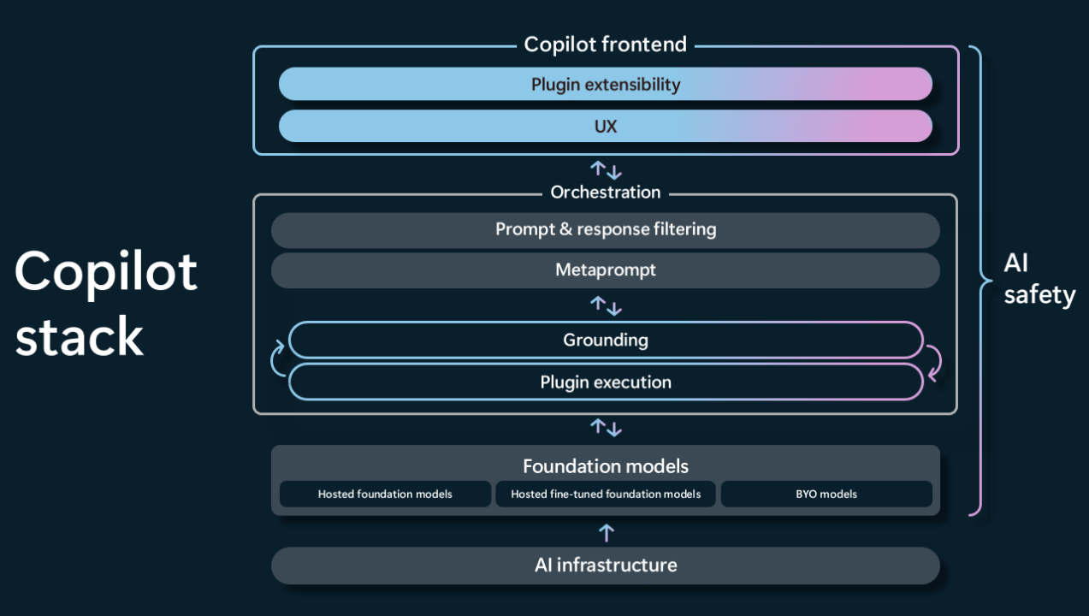
AI: Azure & Microsoft
Copilots Github | PowerApp | Power Automate | PowerBI | Windows
Azure AI Studio
Azure ML Studio Machine Learning / AI Infrastructure
Azure OpenAI, AI Search & AI Services
Models as a Service
AI in Azure Products PostgreSQL / Vector Embeddings
ML.NET; Model Builder
Semantic Kernel
Notes:
https://www.microsoft.com/en-us/ai

Slide 13
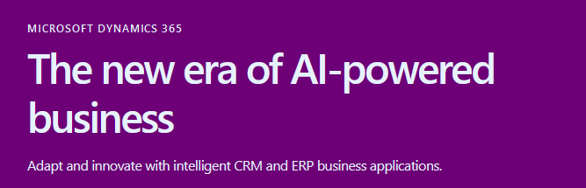
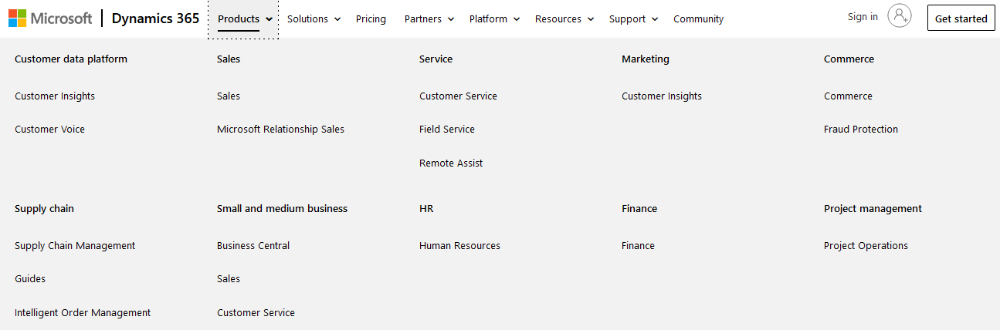
Dynamics 365
Common Data Model
Power Platform Integration Dataverse | Power Apps | Power Automate | PowerBI
Notes:
https://www.microsoft.com/en-us/dynamics-365

Slide 14
Demos
Azure / .NET App
.NET Containers App (.NET as a good citizen in Containers / CNCF)
.NET ASPIRE

Slide 15
.NET & Azure: Resources
Conferences Need to add
Learning Resources Need to add
Blogs Need to add
Social Media / Youtube Need to add

